Slide 1
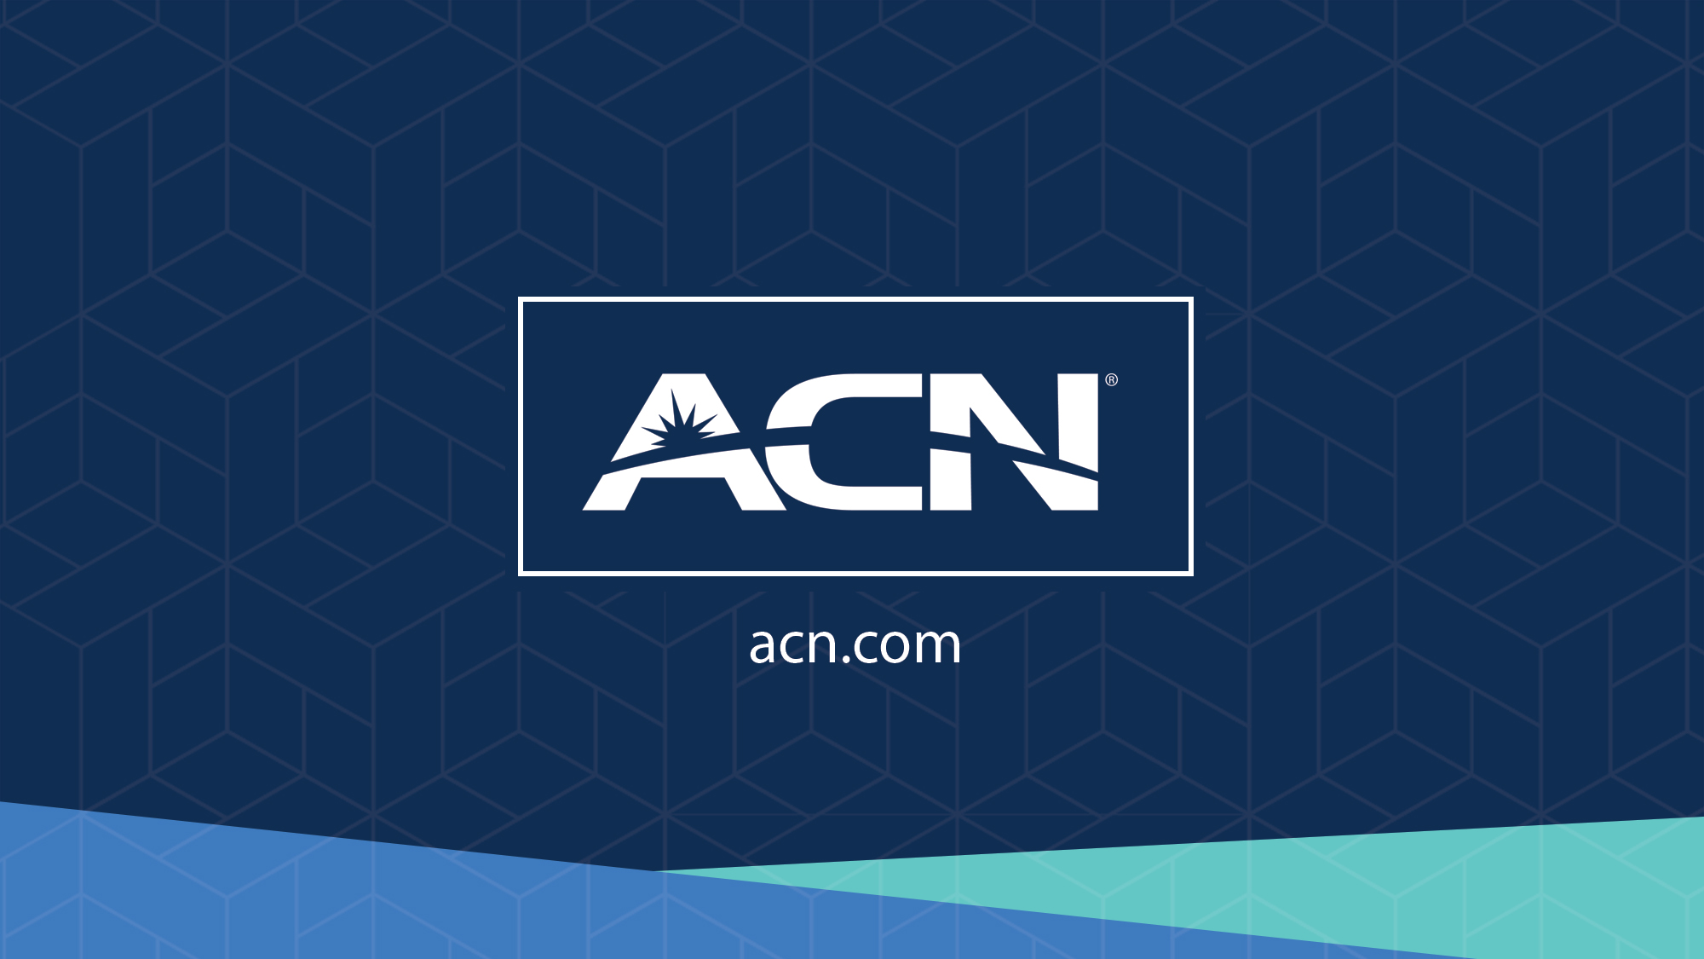

Slide 2
Refer to the ACN Compensation Plan for complete details. Earnings as an ACN IBO are based solely upon the successful sale of products to customers and their usage of those products. Individuals will incur expenses in operating their ACN business, such as the sign-up and monthly business support fees, as well as other possible operating expenses. As with any business, earnings and success at ACN are not guaranteed but depend primarily on the individual’s persistence, effort and results of acquiring customers personally and/or through their team. Individuals will not earn income and will lose money as an IBO if customers are not acquired.

Slide 3






1
Company
An Established Track Record
Service Provider Specializing in Customer Acquisition
Started
in the U.S.
January 1993
27 Countries,
5 Continents
$4 Billion in Sales Over the Last
5 years & Growing
Millions
of Customers Acquired

Slide 4








2
Essential Residential Business Services
Wireless
High-Speed Internet
Television
Energy
Security & Automation
Payment Processing
identity theft protection
BUNDLE
Data Breaches & Cybercrime are the biggest threats facing consumers today.
Over 145 million personal records exposed or stolen in 2019 alone.*
85% of American families currently have no Identity Theft Protection.
IDSeal Proprietary Protection provides industry-leading monitoring, alerts
and restoration services.
IDENTITY THEFT PROTECTION
*SOURCE: Identity Theft Resource Center, Data Breach Report, (Date: 8/12/19)

Slide 5




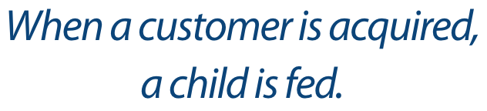


Slide 6








3
Our Business Model
Most Service Providers
Media & Internet Marketing
YOU
CUSTOMERS

Slide 7




4
Become an Independent Business Owner (IBO)
$199 Start-Up + $25/month Business Support
Personalized Website
Compass Online &
Marketing Tools
Complete Business
Tracking & Reporting
Complete Customer Support

Slide 8
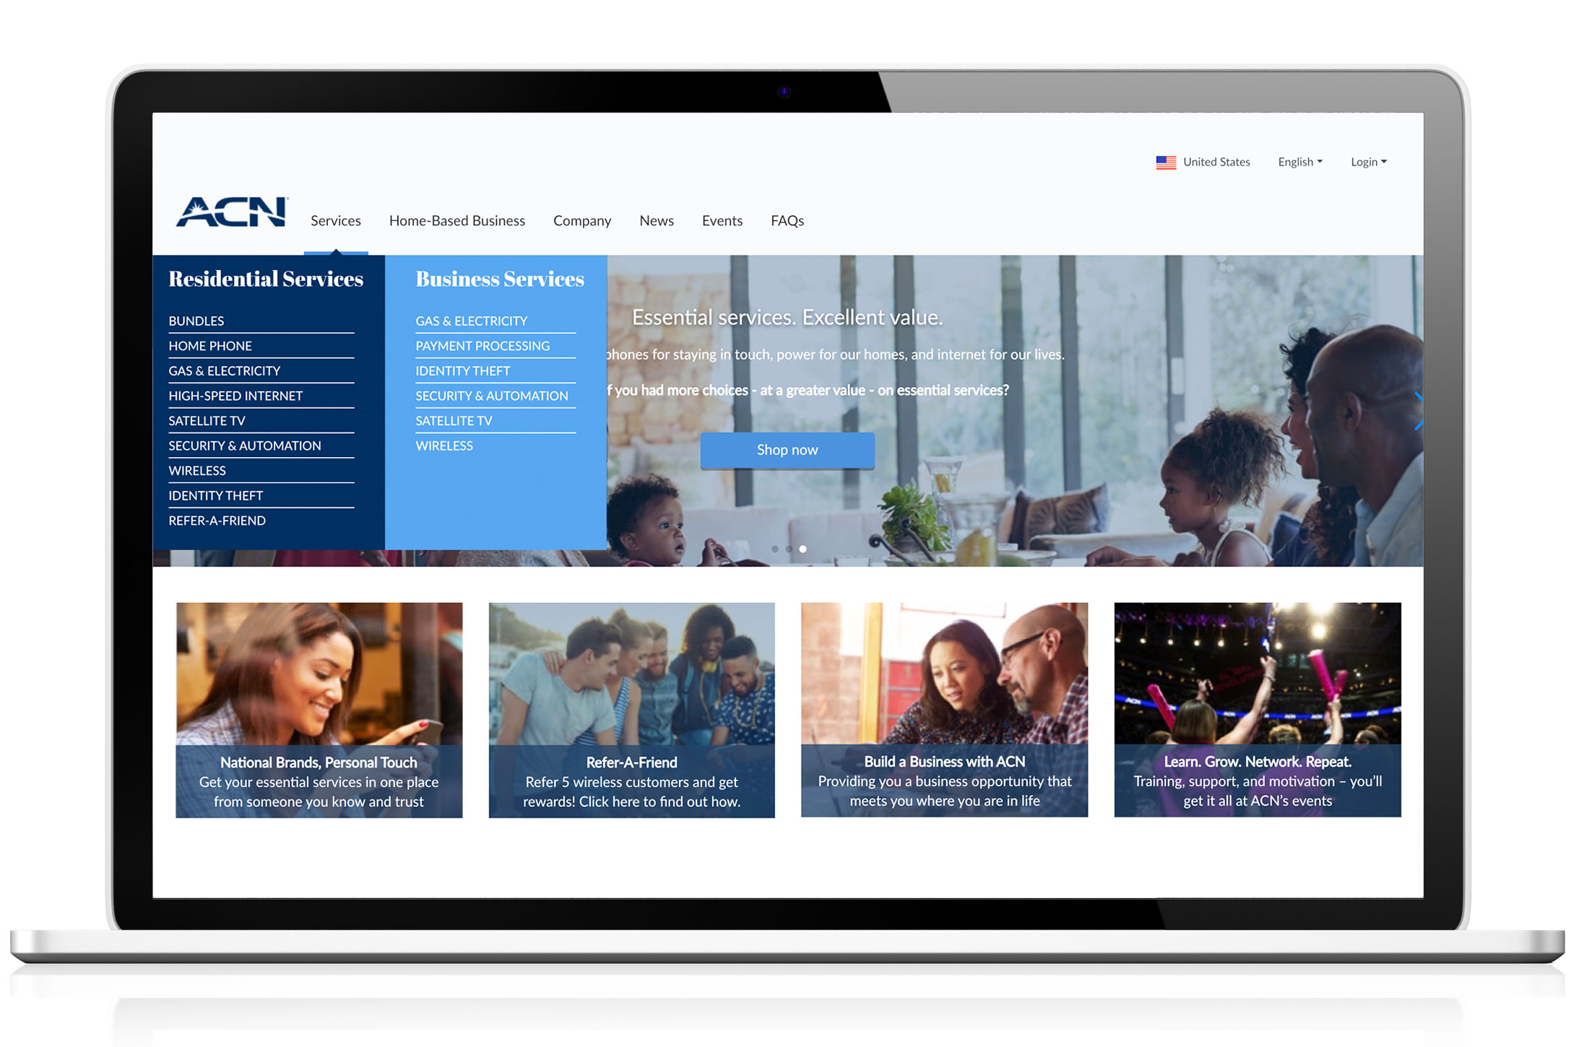
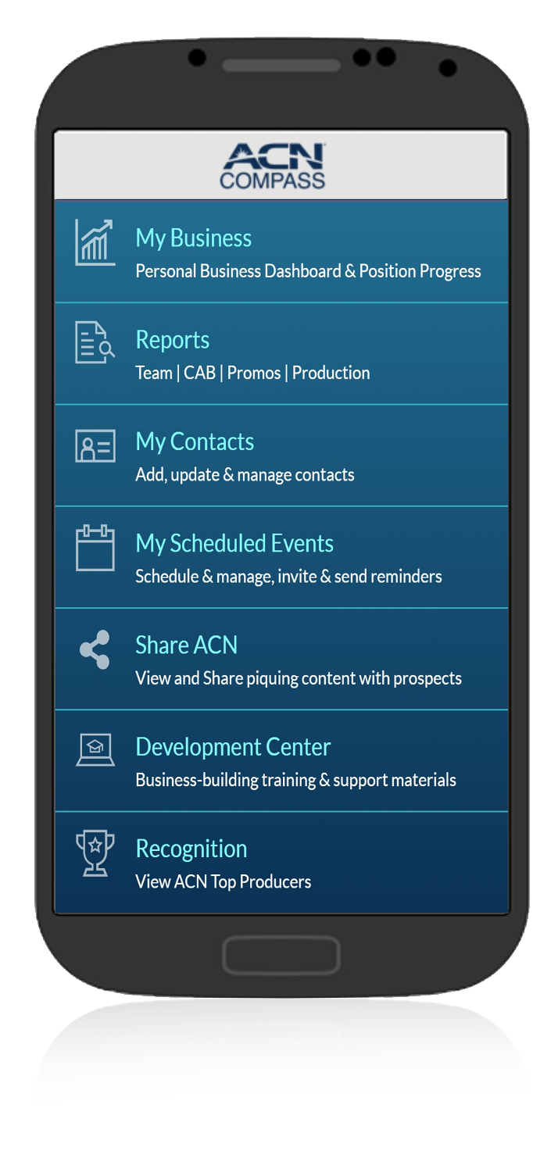
You Get Your Own Online Business!

Slide 9



5
Personal Monthly Customer Bonuses
Acquire Customers Totaling:
3 Services = $75
5 Services = $200
8 Services = $400
11 Services = $600
Plus $200 for Every Additional 3 Services
Refer to the ACN Compensation Plan for point requirements and complete details!

Slide 10
6
Personal Residual Income
Your Customers
3% TO 20%
Monthly Commissionable Revenue*
*Refer to the ACN Compensation Plan for details!

Slide 11

Overriding
Customer Acquisition Bonuses (CABs)
7
Your TEAM’s Customers
Opportunity to earn bonuses that are paid weekly when your TEAM acquires customers.*
$50 - $300
*Refer to the ACN Compensation Plan for details!

Slide 12

Overriding
Residual Income
8
Your TEAM’s Customers
4%
Monthly Commissionable
Revenue*
*Refer to the ACN Compensation Plan for details!

Slide 13
CQ
ETL
RD
RVP
SVP
9
IBO Earned Positions
Increased Customer Acquisition Bonuses (CABs)
Increased Residual
Reaching higher earned positions is based on the number of personal and team customers.*
Incentive Trips
*Refer to the ACN Compensation Plan for details!

Slide 14

10
Next Steps
vA
vA
Enroll as an IBO
Utilize Support System
In Business for Yourself, NEVER By Yourself!
vA
vA
Participate in Training
Start Acquiring Customers

