Slide 1
Virginia – Natural Gas
APRIL 2018 MARKET INFORMATION
XOOM ENERGY’S VARIABLE INTRO RATE PLAN IS CURRENTLY LOWER THAN THE LOCAL UTILITY:
Washington Gas of Virginia
(New RESIDNTIAL Customers Only – First 2 Billing Cycles)
Available to over 490,000 Virginia Customers
Residential Variable Rate Plan: SimpleFlex

Slide 2
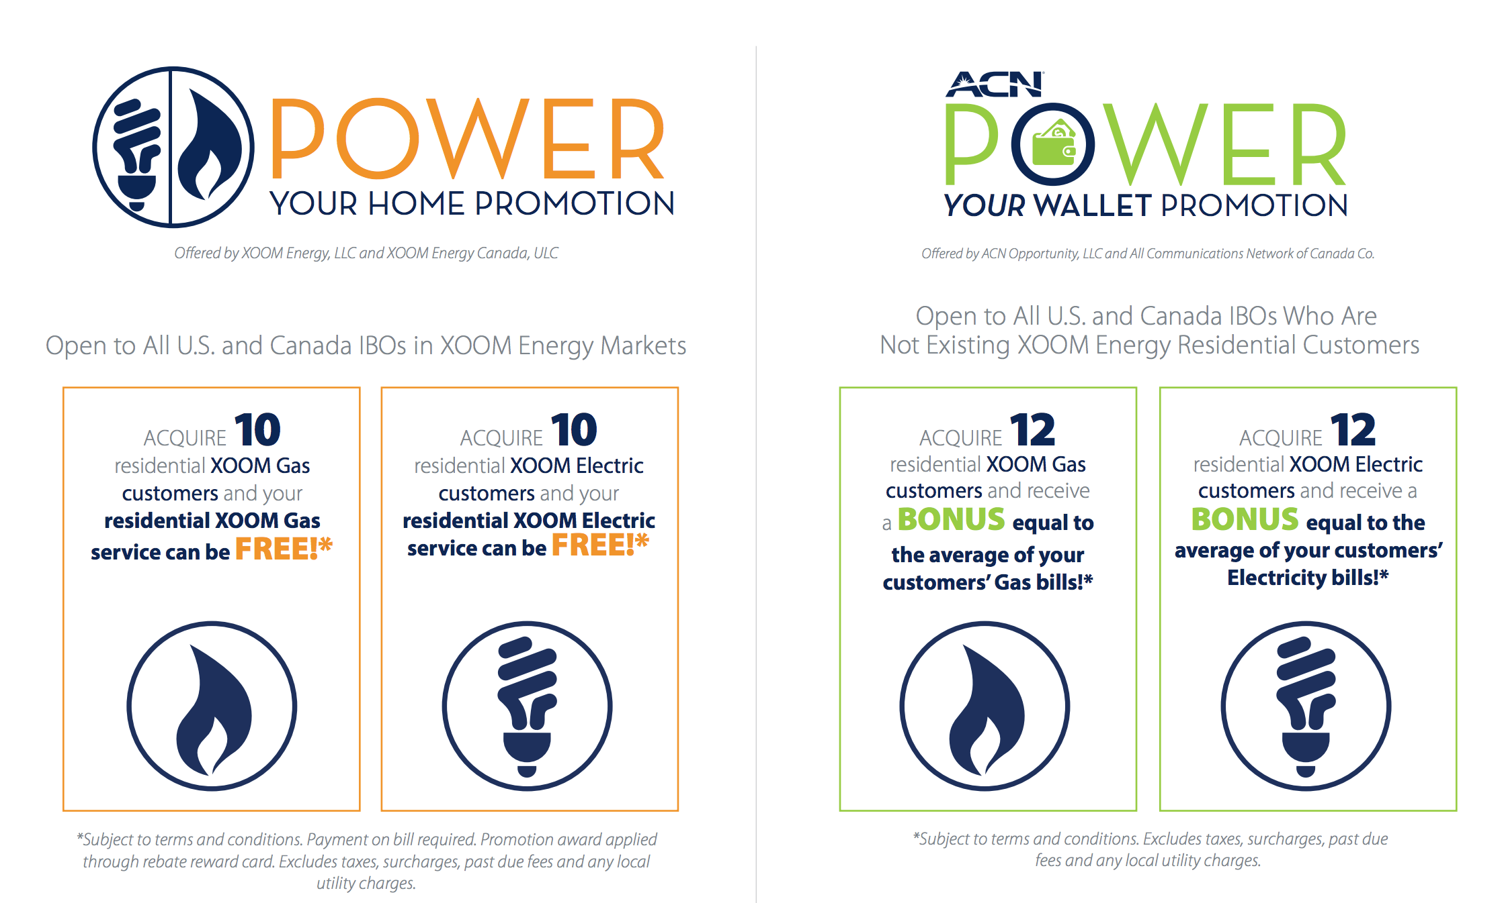
*See your IBO Back Office for details

