Slide 1
Alberta – Electricity & Natural Gas
AUGUST 2018 MARKET INFORMATION
Take the surprise out of your monthly electric and natural gas bills, enroll in SteadyLock 24 and pay one flat monthly price. Worry less each month when you lock in your rate for 24 full months.
Alta Gas
ATCO - Electricity
ATCO - Gas
City of Lethbridge - Electricity
ENMAX Power Corporation - Electricity
EPCOR – Electricity
FortisAlberta - Electricity
Visit https://acn.xoomenergy.ca/en/residential/alberta for more information.

Slide 2
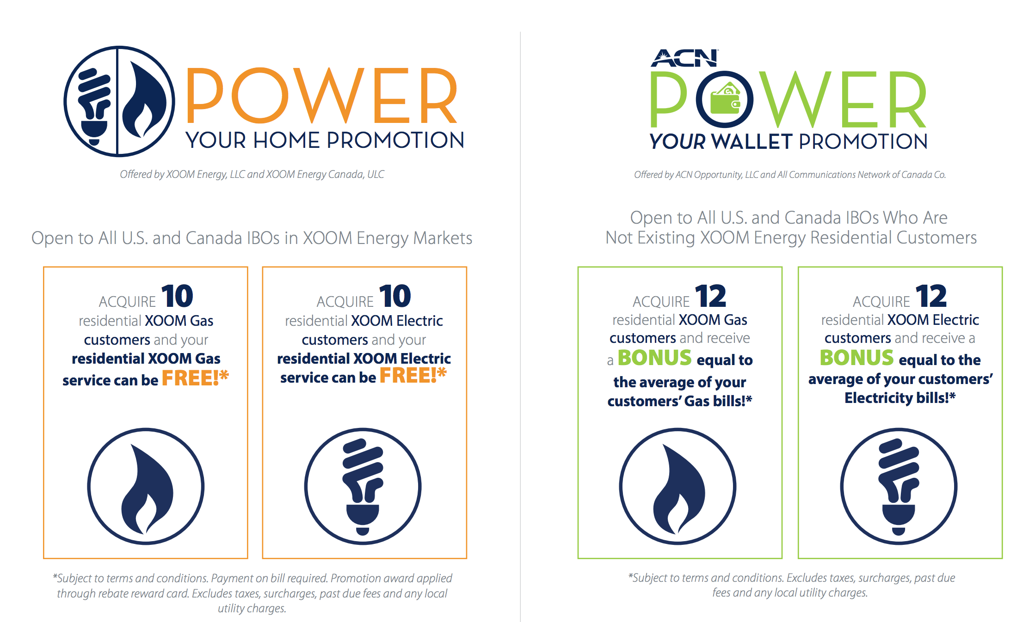
*See your IBO Back Office for details

