Slide 1
U.S. Residential High Speed Internet

Slide 2
High-Speed Internet
High-Speed Fiber and DSL broadband options from two top providers:
FIBER
DSL
*Availability and speeds vary by customer location.

Slide 3
Why Sell High-Speed Internet?
Home Internet has become an essential service!
In 2000, only 1% of Americans had broadband Internet service at home
As of 2016, more than 73% of Americans have home Internet service!
Same great service and promotions as the carrier companies
Your customers receive Internet service and complete customer care from four top providers
Your customers have access to the same promotions offered by the carriers
High-value customers
Commissions and points for 2 years
Worth 1-3 Customer Points (varies by carrier) – please refer to the ACN Compensation Plan for complete details
Not every package or term option is available through ACN. Above data refers to broadband internet statistics from Pew Research Center issued January 11, 2017. http://www.pewresearch.org/fact-tank/2017/01/12/evolution-of-technology/ft_17-01-10_internetfactsheets

Slide 4
Access to Higher Internet Speeds
The Power of 100 Mbps
Great for streaming multiple HD movies
Connect 4-6 devices with no lag
Game on with multi-player video games
Hardcore Streaming
1080 HD
10 Songs
in 3.2 sec
20 photos
in 6.4 secs
500 MB
in 40 sec
The Power of 40 Mbps
Great for streaming multiple movies
Connect 2-4 devices
Game on with online video games
Heavy Streaming
1080 HD
10 Songs
in 8 sec
20 photos
in 16 secs
500 MB
in 1.7 min
The Power of 12 Mbps
Great for downloading movies
Connect 1-2 devices
Surf and download files
Moderate Streaming
1080 HD
10 Songs
in 27 sec
20 photos
in 53 secs
500 MB
in 5.57 min
*Internet speeds are subject to availability by location and are “up to” the speed selected. Speeds vary based on customer location, connection type, and other conditions.

Slide 5
Target Market
Residential Customers Only
Digital Phone Service Customers
Wireless-Only Households
Customers Looking for Higher Speeds
Must be a New Internet Customer of the Carrier See details on the “Setting Customer Expectations” slide.

Slide 6
High-Speed Internet
AT&T Fiber & DSL
The largest Fiber and DSL provider in the U.S. by coverage area
Offers Internet in 21 states
DSL is available to 120.7 million people
Fiber is available to over 30 million people
Speeds up to 75 Mbps
Internet statistics provided by Broadbandnow.com. Internet speeds are subject to availability by location. “Up to” speeds based on optimal conditions using a wired connection. Fiber will only display where both Fiber and DSL are available.

Slide 7
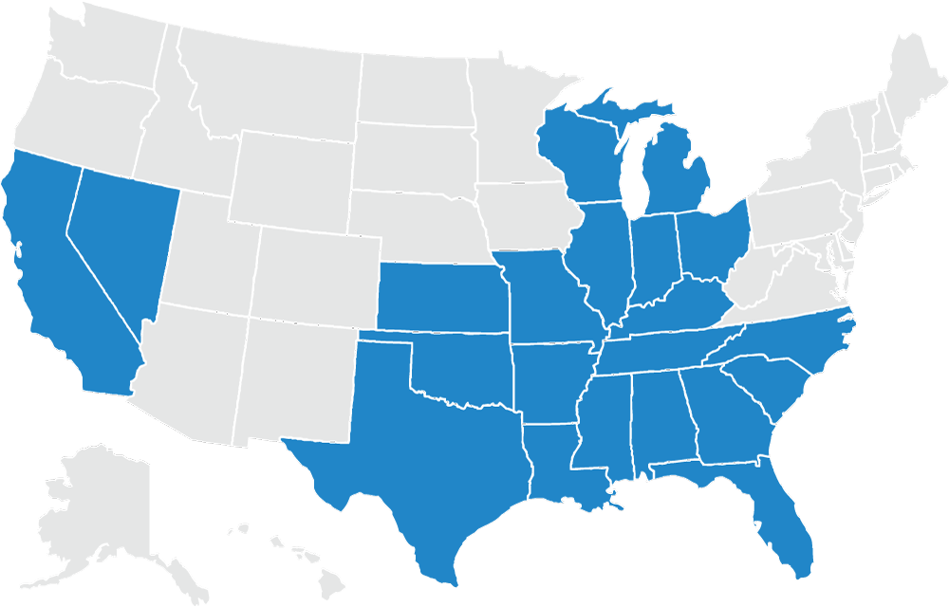
Availability of High-Speed Internet
IN AT&T TERRITORIES
Alabama
Arkansas
California
Florida
Georgia
Illinois
Indiana
Kansas
Kentucky
Louisiana
Michigan
Mississippi
Missouri
Nevada
North Carolina
Ohio
Oklahoma
South Carolina
Tennessee
Texas
Wisconsin
Fiber and DSL

Slide 8
High-Speed Internet
Frontier FiOS and DSL
4th largest DSL provider in the U.S. by coverage area
DSL is available to 28.7 million people in 29 states
3rd largest Fiber provider in the U.S. by coverage area
Fiber is available to 9.8 million people in 7 states, including* these key cities:
Speeds up to 150 Mbps
Huntington Beach, CA Long Beach, CA Los Angeles, CA St Petersburg, FL Sarasota, FL | Tampa, FL Redmond, WA Seattle, WA Hillsboro, OR Portland, OR | Plano, TX Irving, TX Denton, TX Fort Wayne, IN N. Myrtle Beach, SC
*Fiber available in seven states, including but not limited to cities listed above. Internet statistics provided by Broadbandnow.com. Internet speeds are subject to availability by location. “Up to” speeds based on optimal conditions using a wired connection.

Slide 9
Frontier Secure
Personal and Identity Security
From technical support to online security solutions, Frontier Secure™ is your partner for all of the digital technology throughout your home. Two great options available with your Frontier High Speed Internet Service:
Personal Security Bundle
Secure cloud storage and software to help protect your devices featuring:
Multi Device Security for up to 10 devices
Secure Password Manager easy access to all your passwords, usernames, and credit card details with one master password
Content Anywhere provides 50GB of storage capacity with state-of-the-art online security
Identity Security Bundle
Identity protection services and online security software featuring:
Multi Device Security for up to 10 devices
Secure Password Manager easy access to all your passwords, usernames, and credit card details with one master password
Identify protection with triple-bureau credit monitoring, I.D. monitoring and SSN trace monitoring

Slide 10
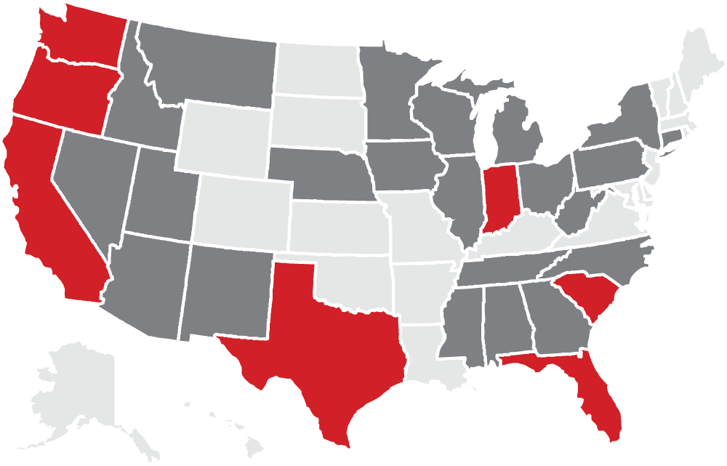
Availability of High-Speed Internet
Alabama
Arizona
California*
Connecticut
Florida*
Georgia
Idaho
Illinois
Indiana*
Iowa
Michigan
Minnesota
Mississippi
Montana
Nebraska
Nevada
New Mexico
New York
North Carolina
Ohio
Oregon*
Pennsylvania
South Carolina*
Tennessee
Texas*
Utah
Washington*
West Virginia
Wisconsin
IN FRONTIER TERRITORIES
DSL Only
*Fiber and DSL

Slide 11
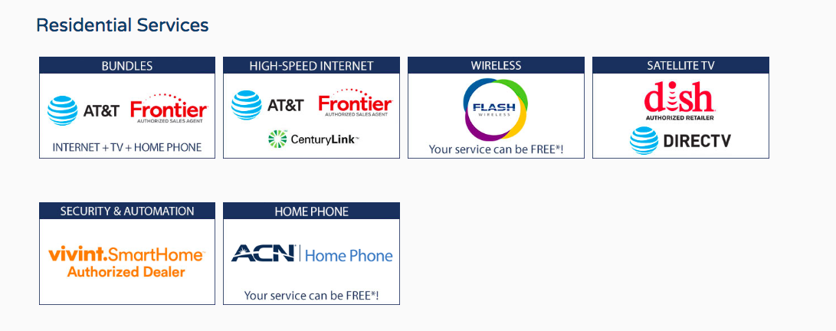
How to Order
All orders must be submitted online, via the ACN order portal
Direct customers to your ACN Storefront and select Internet
Online order portal is available on all browsers and mobile devices
Some providers may direct customers to contact them to complete the sale

Slide 12
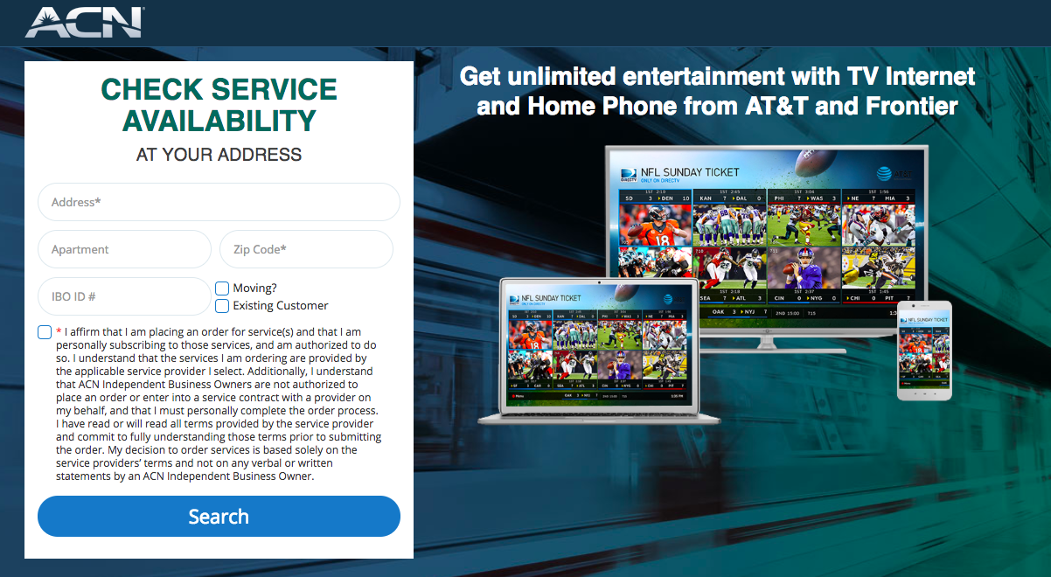
Check Service Availability
Customer enters address to see offers available in their area
Your IBO# should be visible in the IBO ID# field
Click “Find the Best Deals”

Slide 13
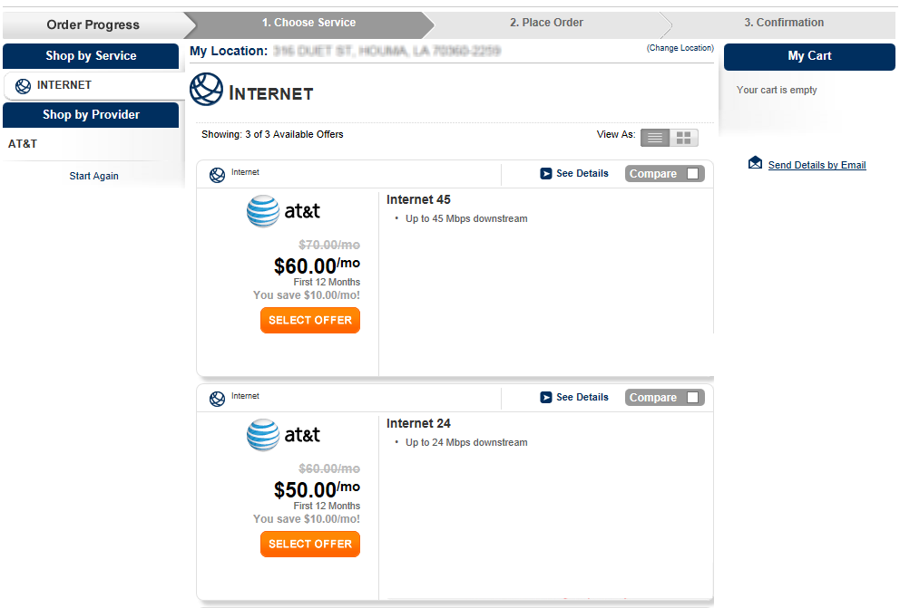
Review and Choose Service
Internet offers are displayed from highest to lowest speed*
Review offers, pricing and promotions
Click “See Details” for more information about Features / Benefits, Pricing, Promotions, and Bonus offers
Once purchase decision is made, customer should select desired Offer
*Internet speeds are subject to availability by location. “Up to” speeds based on optimal conditions using a wired connection.

Slide 14
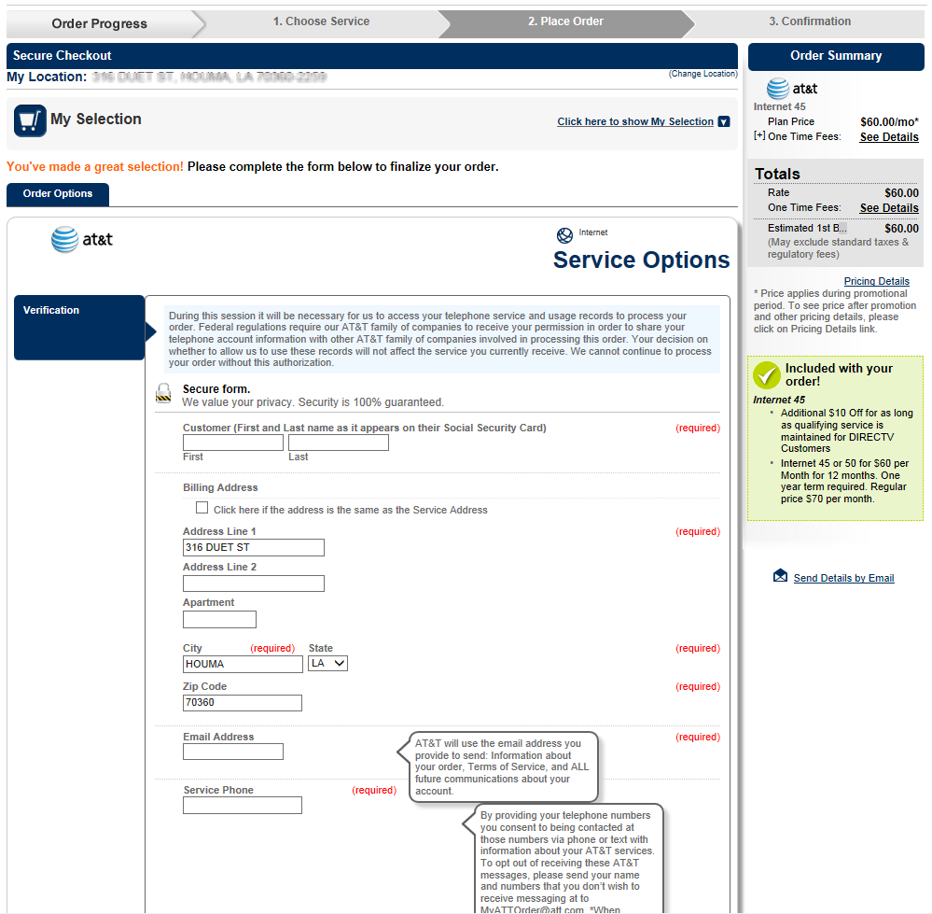
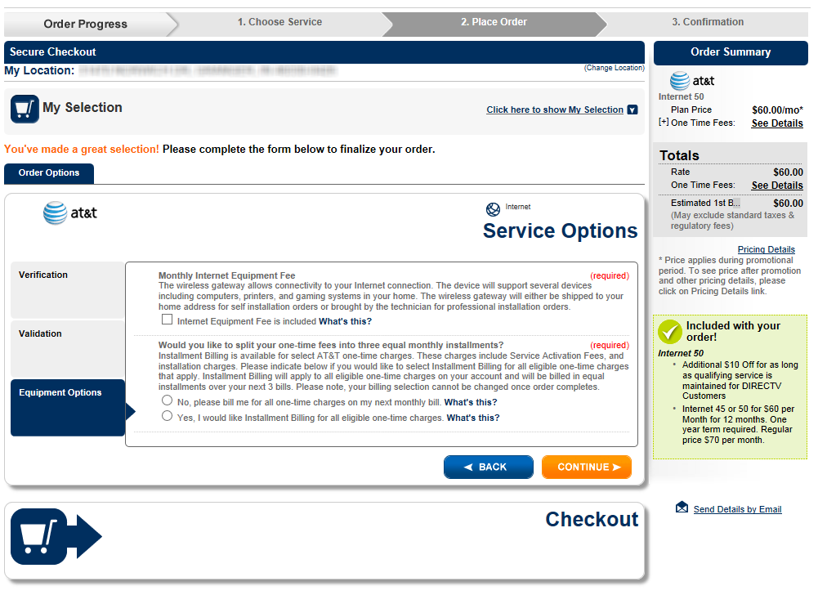
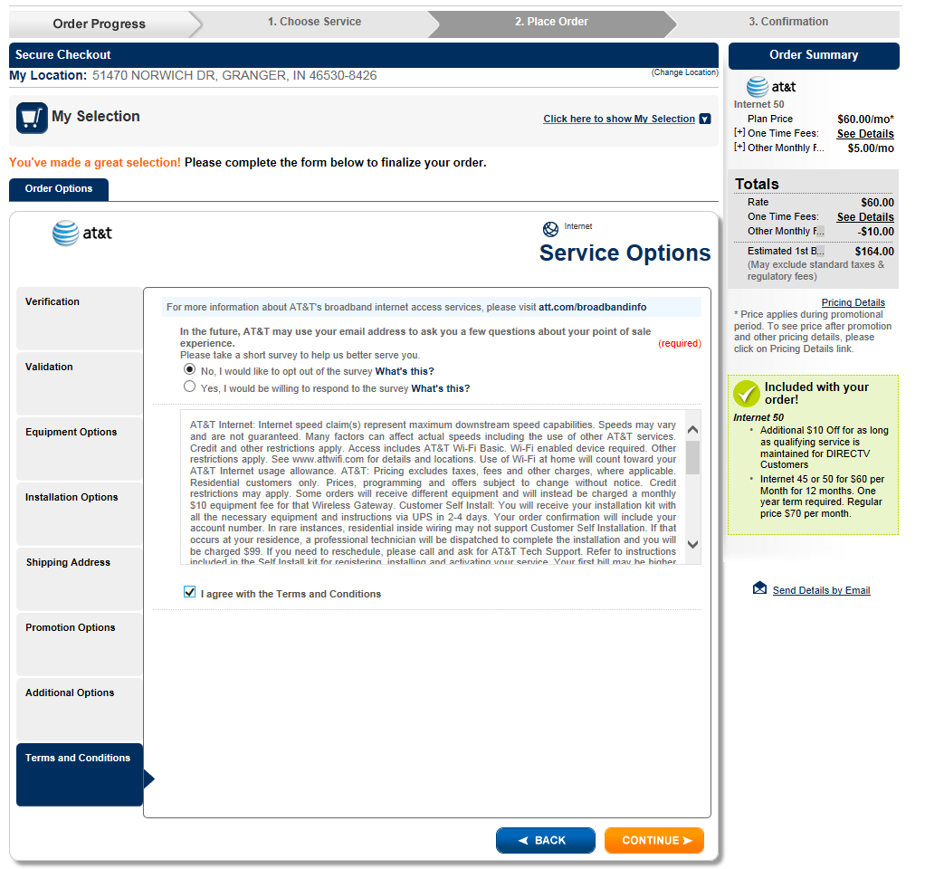
Place Order
Customer must complete the customer information:
Select Offer Options
Enter Account Options
Enter Shipping Address
Agree to Terms and Conditions
Schedule Installation, where applicable
Complete Billing information, if requested

Slide 15
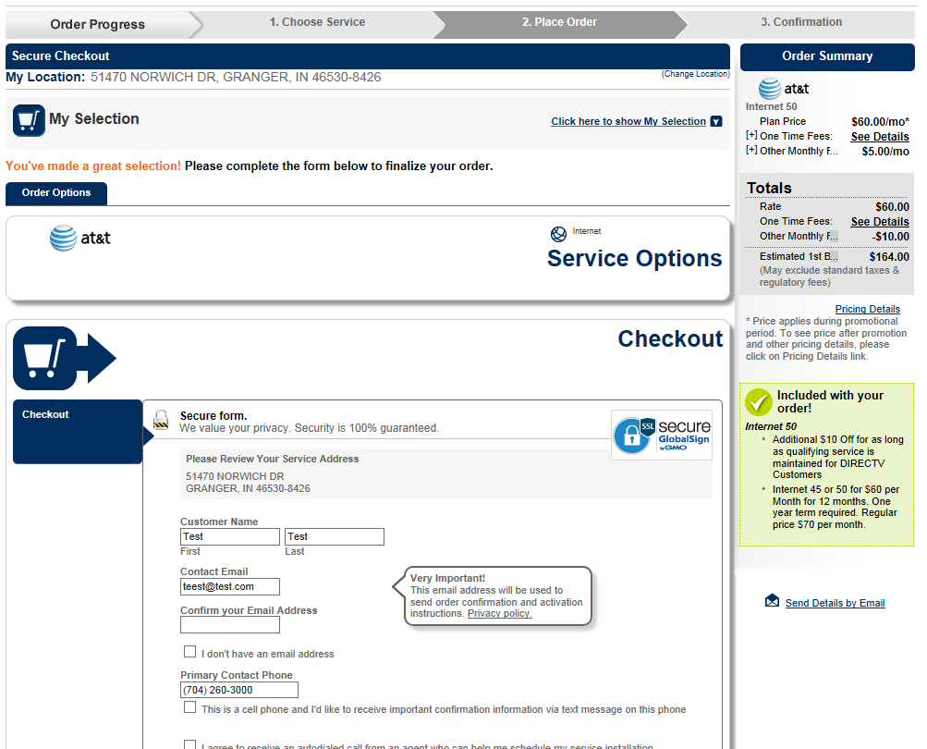
Check Out
Complete the sign-up information
After the customer places their order, instructions will be supplied from the provider on how to schedule installation (if required).
Customers can also connect directly to some providers by clicking on the "Schedule Your Installation" link on the next page.
TIP: Entering a Social Security Number results in a more accurate order and higher activation rate

Slide 16
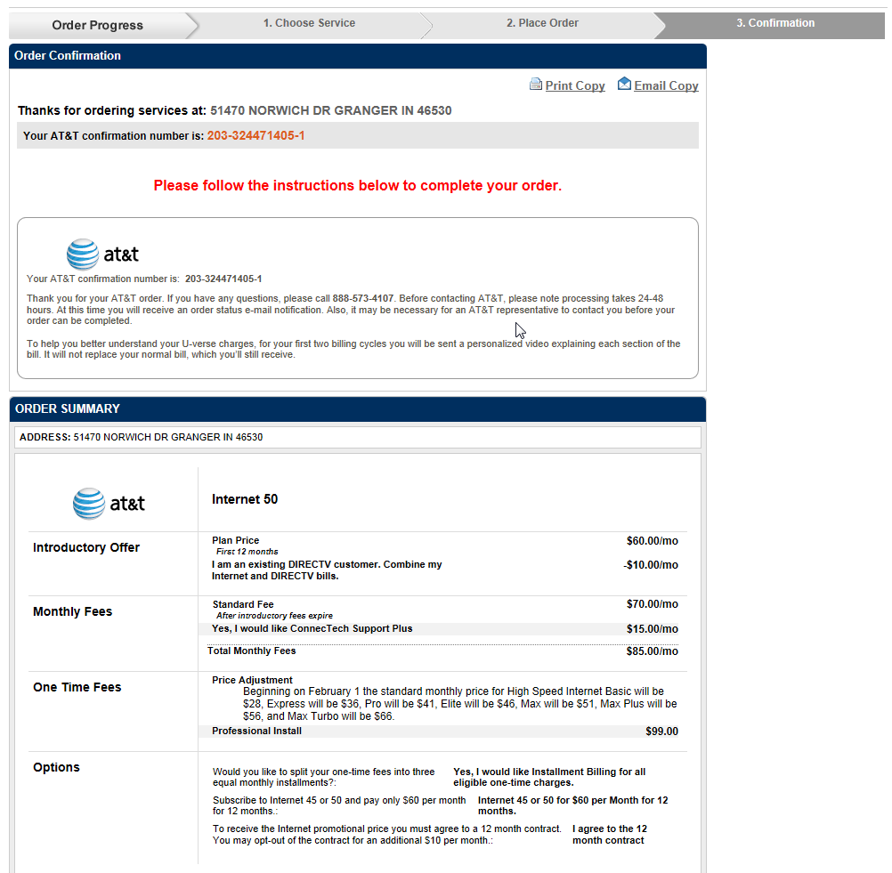
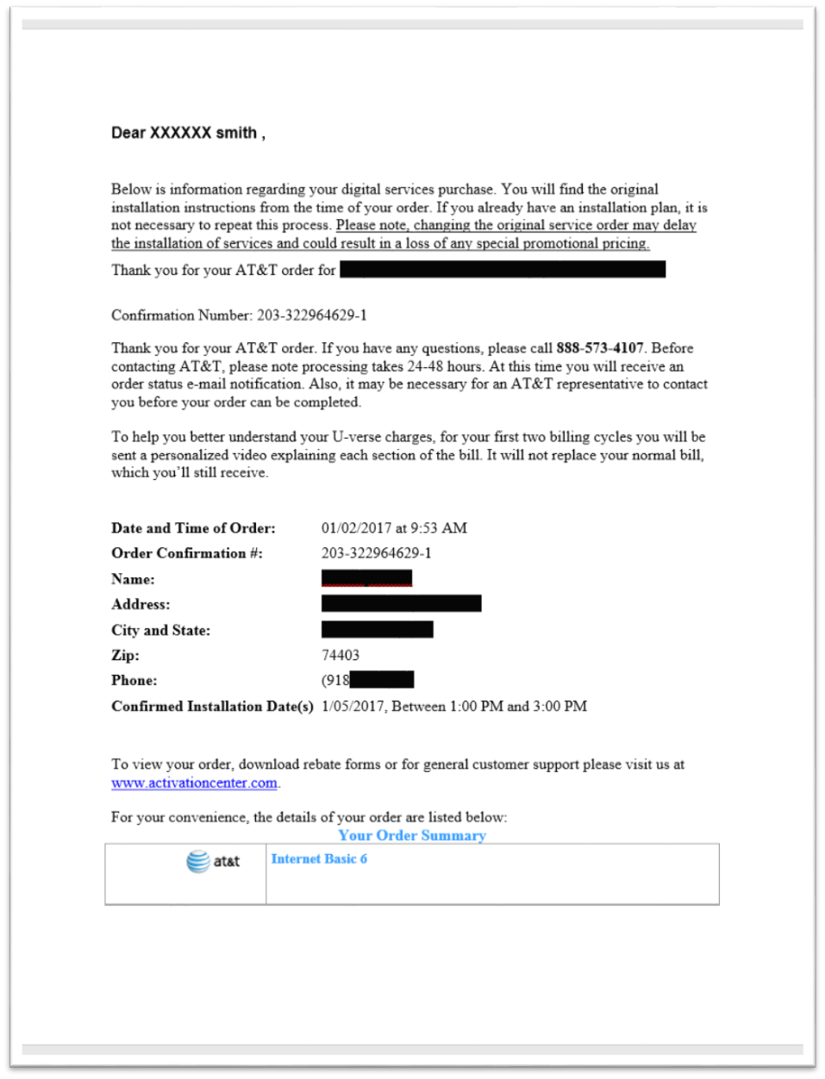
Order Confirmation
Confirmation message will be displayed with any additional installation instructions and information on how to change the installation date and time, if needed
Customer will be sent a confirmation email summarizing service selection and order details
TIP: Ensure that your customer reads their confirmation screen and email in its entirety and follow all instructions to complete the sale

Slide 17
Customer Data Points
Providers will check 3 data points to find former customers: Name, Address and SSN. The same 3 data points are used to validate the order.
Ensuring
Orders
Activate Successfully
Previous Customer?
Did the customer have service with this carrier in the last 60-180 days? If so, they may not be able to sign up through ACN.
Outstanding Bills?
When they last had the provider, did the customer leave in good standing? If not, they may be rejected.
Order Changes
Order changes should be made after installation, if possible. Customer should call ONLY the 800# shown on their confirmation email, not ACN.
All providers will perform a credit check. A deposit or advance payment may be required in order to schedule the installation. Follow instructions on the confirmation email to complete the order.
Set Expectations

Slide 18
Setting Expectations
Can existing customers of the carrier sign up for service through ACN? No.
Can former customers of the carrier sign up for service through ACN? Yes, with the following restrictions:
AT&T – Must wait 60 days
Frontier – Must wait 120 days
Why are some speeds not displaying? Not every package or term option is available through ACN (for example, the lowest DSL speeds). The availability tool will only show results for packages available through ACN in the customer's area. Some speeds are only available in a bundle.
Can my customer sign up for current promotions? Yes, current promotions offered by the carrier are displayed during the ACN internet sign-up process.

Slide 19
Setting Expectations
How will service be installed? Installation varies by provider and service:
DSL: Easy self-installation is available for most customers; equipment is shipped to customer’s home (typically within 7-10 business days)
Fiber and Higher DSL Speeds: Professional installation is required; technician delivers the modem (within 10-14 business days)
What if my customer needs to change their order? Please have your customer follow the instructions on the confirmation email to make changes to an order. They should not call the provider or ACN directly. Orders may take 24 hours to appear with the provider. Speed changes should be made after installation, to ensure ACN credit is received for the sale.
Who should my customer contact for assistance? Customer Service and Billing will be provided by the carrier. Contact information will be provided in the confirmation email.

Slide 20
How Do ACN Offers Differ From Carrier?
Lower DSL speeds offered by the carrier may not be offered through ACN to ensure best customer experiences
Certain speeds may only be available in a bundle
ACN may not provide all carrier term plan options
Fiber Internet products do not include TV or Phone Bundles
Frontier may display the same rate plan multiple times, with slightly different promotional offers

