Slide 1
Connecticut – Electricity
AUGUST 2018 MARKET INFORMATION
XOOM ENERGY’S FIXED RATE PLANS ARE CURRENTLY LOWER THAN THE LOCAL UTILITY:
Eversource Energy (formerly CL&P)
Residential Fixed Rate Plans: SureLock 4
United Illuminating
Residential Fixed Rate Plans: SureLock 4
Business Fixed Rate Plans: BizLock 4
Available to over 1.5 Million Connecticut Customers
Visit https://acn.xoomenergy.com/en/residential/connecticut for more information.

Slide 2
Maine – Electricity
AUGUST 2018 MARKET INFORMATION
XOOM ENERGY’S VARIABLE INTRO RATE PLANS ARE CURRENTLY LOWER THAN THE LOCAL UTILITY:
Central Maine Power
New Customers ONLY - First 2 Billing Cycles
Emera Maine (formerly Bangor Hydro)
New Customers ONLY - First 2 Billing Cycles
Available to over 730,000 Maine Customers
Residential Variable Rate Plan: SimpleFlex
Business Variable Rate Plan: BizChoice
Visit https://acn.xoomenergy.com/en/residential/maine for more information.

Slide 3
Massachusetts – Electricity
AUGUST 2018 MARKET INFORMATION
XOOM ENERGY’S VARIABLE INTRO RATE PLANS ARE CURRENTLY LOWER THAN THE LOCAL UTILITY:
Eversource Energy (NSTAR - NE, SE, WMCO)
New RESIDENTIAL Customers ONLY - First 2 Billing Cycles
National Grid (Massachusetts Electric NE, SE, WC and Nantucket)
New RESIDENTIAL Customers ONLY - First 2 Billing Cycles
Available to over 2.5 Million Massachusetts Customers
Residential Variable Rate Plan: SimpleFlex
Visit https://acn.xoomenergy.com/en/residential/massachusetts for more information.

Slide 4
New Hampshire – Electricity
AUGUST 2018 MARKET INFORMATION
XOOM ENERGY’S VARIABLE INTRO RATE PLANS ARE CURRENTLY LOWER THAN THE LOCAL UTILITY:
Eversource Energy (Public Service of NH)
New Customers ONLY - First 2 Billing Cycles
Available to over 500,000 New Hampshire Customers
Residential Variable Rate Plan: SimpleFlex
Business Variable Rate Plan: BizChoice
Visit https://acn.xoomenergy.com/en/residential/new-hampshire for more information.

Slide 5
Rhode Island – Electricity
AUGUST 2018 MARKET INFORMATION
XOOM ENERGY’S VARIABLE INTRO RATE PLANS ARE CURRENTLY LOWER THAN THE LOCAL UTILITY:
National Grid – Narragansett Electric
New RESIDENTIAL Customers ONLY - First 2 Billing Cycles
Available to over 490,000 Rhode Island Customers
Residential Variable Rate Plan: SimpleFlex
Visit https://acn.xoomenergy.com/en/residential/rhode-island for more information.

Slide 6
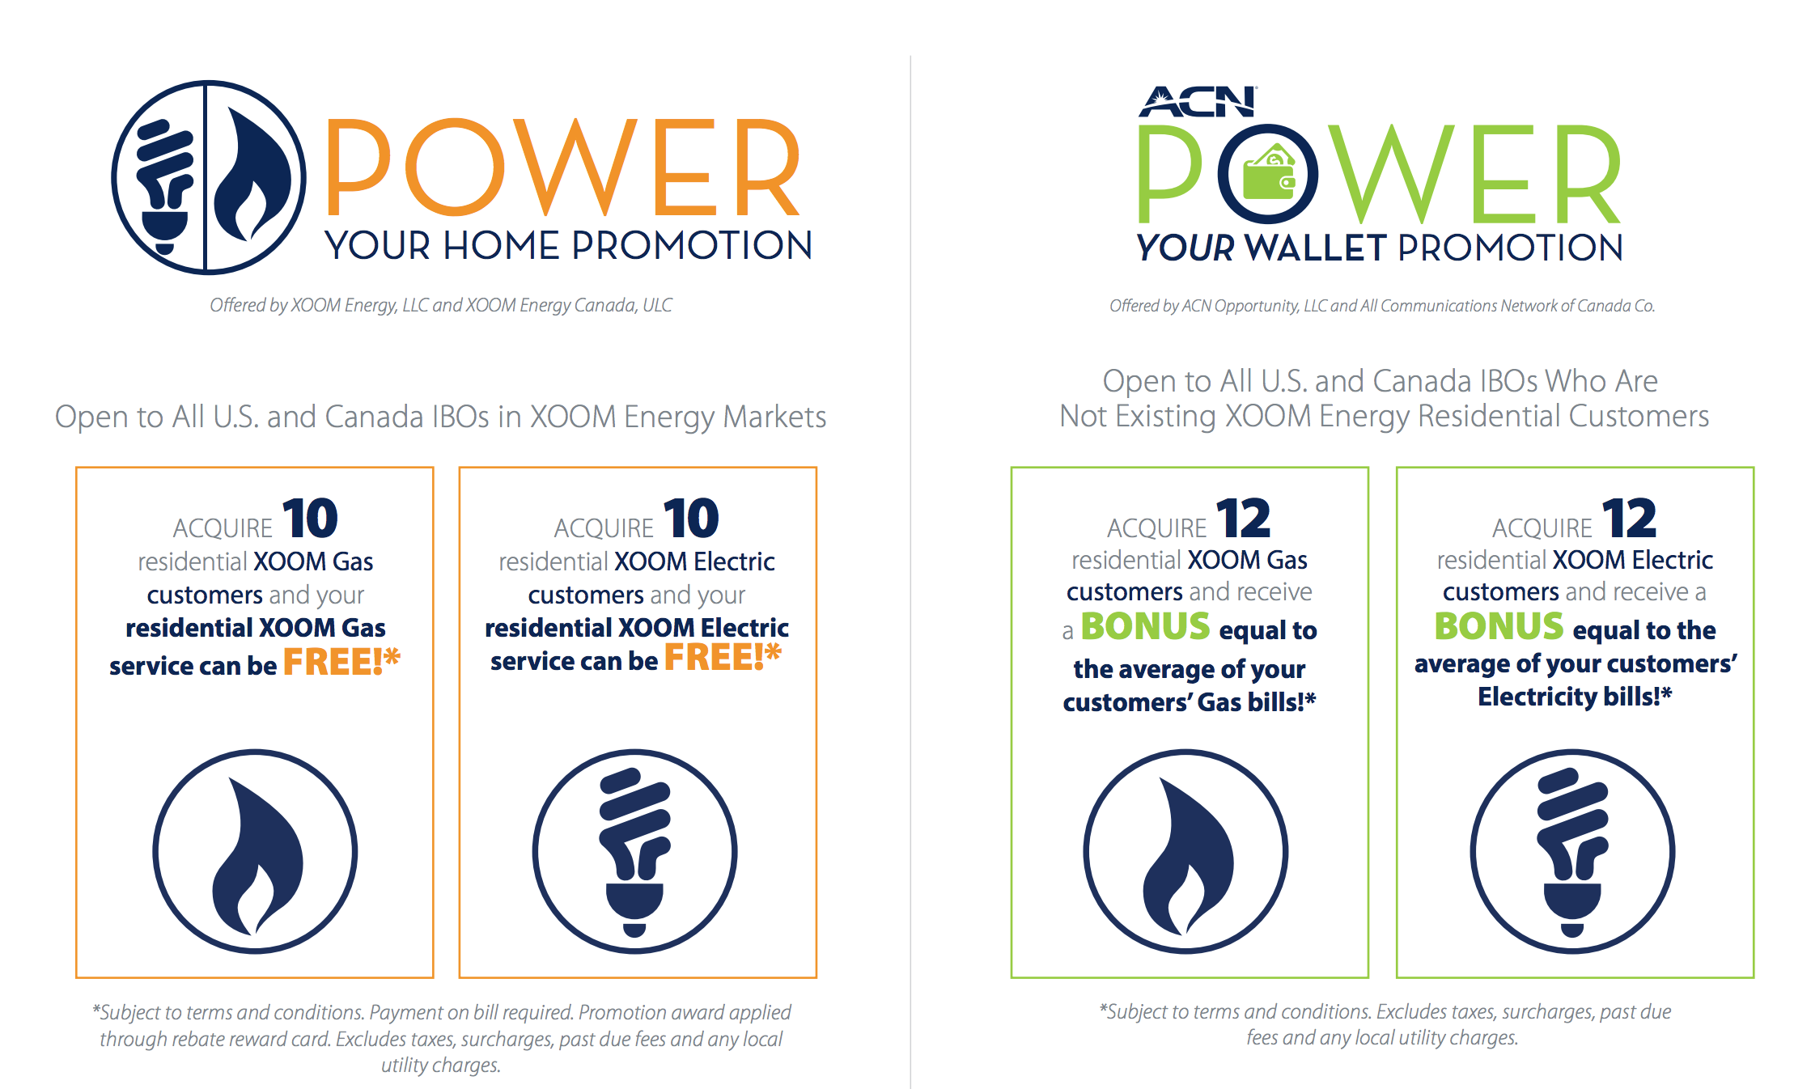
*See your IBO Back Office for details

