Slide 1
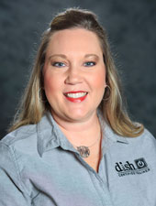
Virtual Product Training
Webinar
Andrea Wangle-Cavanagh
Senior Strategic Development Trainer
Notes:
“Hi, welcome to the ACN-DISH Virtual Product Training, my name is Andrea Wangle-Cavanagh, I am a Senior Strategic Development Trainer with DISH! I’m here to show you all the advantages of why DISH will be one of your go to services to sell as an IBO as well as show you the all resources we have in place for you to assist you along the way! So let’s get started!”

Slide 2
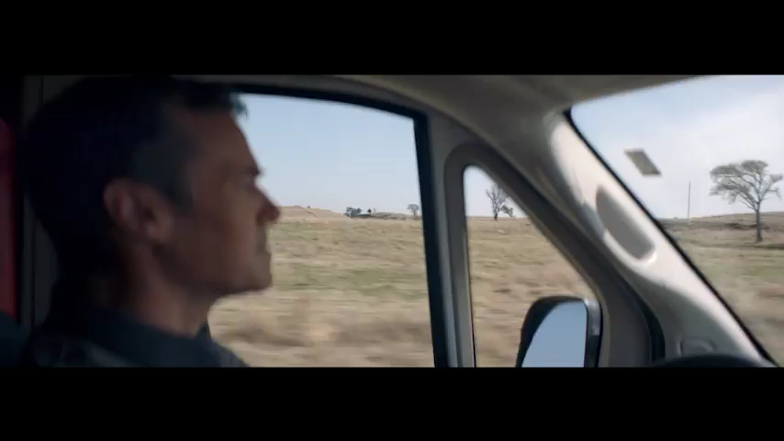
Rural America
Notes:
Today we will walk through the DISH Product, specifically what makes DISH a perfect product for your customer as well as how to access some of the resources and tools that will make you successful when selling DISH.
First, lets begin with one of our commercial spots highlighting DISH in one of ACN’s Key Market Areas, Rural America.
PLAY video
CLICK next slide

Slide 3
ACN Target Customer
Rural Market
DISH is one of two providers available
Much Stickier Customer
Target Audience:
Latino
International
Residential Customers
First Responders
Military
+55 and Over
Healthcare Workers
5 Points for every DISH Activation
Notes:
Target Market:
TALK: Being aware of the type of referral or person you are pitching to is important to optimizing your selling opportunity.
ACN primarily markets to Rural America - where DISH is the best option for Rural Markets
Our Target Audience factors include Residential customers in Single Family Homes selecting English Programming but optimizing DISH’s offerings of both Latino and International packages.
How will selling DISH benefit you as an ACN IBO?
CLICK
ACN offers 5 points for every DISH activation.
Now let’s explore the conversation starter that will help you get the customer excited about DISH.
CLICK next slide

Slide 4
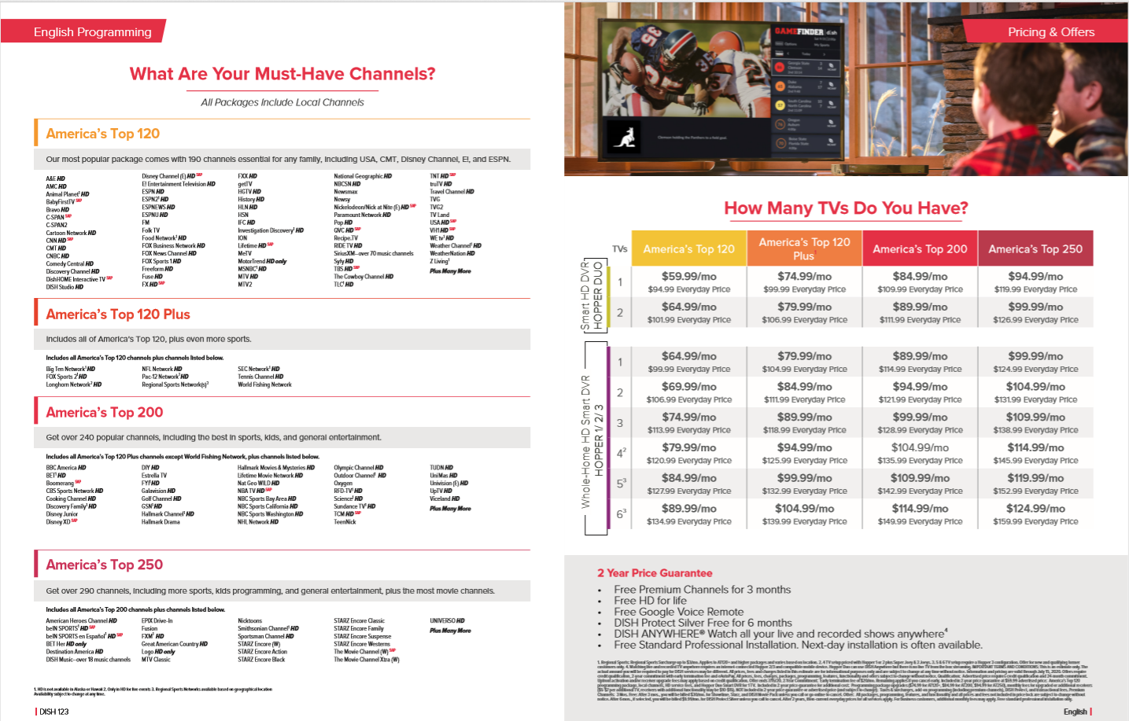
Conversation Starter
Using DISH 1-2-3 Pitchbook as
a resource ask your customer
conversation starter questions:
Who do you use for TV service?
How much are you paying & how many channels do you have with your current provider?
How many TV’s do you have?
Let’s look at a package that would best suit your needs.
http://acncompass.com/dish/
Notes:
Conversation Starter
In order to sell DISH, you have to get your customer excited about the product:
The Dish123 is a great resource located on ACN Compass to utilize when starting a conversation with the customer.
It contains channel guides, pricing and equipment information – go to acncompass.com/dish to find it!
Some questions you can ask customers to get the conversation geared toward TV could be:
Who do you use for TV service currently?
Have you seen the latest episode of Grey’s Anatomy I’ve been recording it on my DVR .
How much are you paying with your current provider?
Maybe I can save you some money on your TV bill too...Let’s talk!
Once we get the conversation started we can move into your Pitch. Let’s talk about some of the Hopper features that your customers will love!
*CLICK to next slide

Slide 5
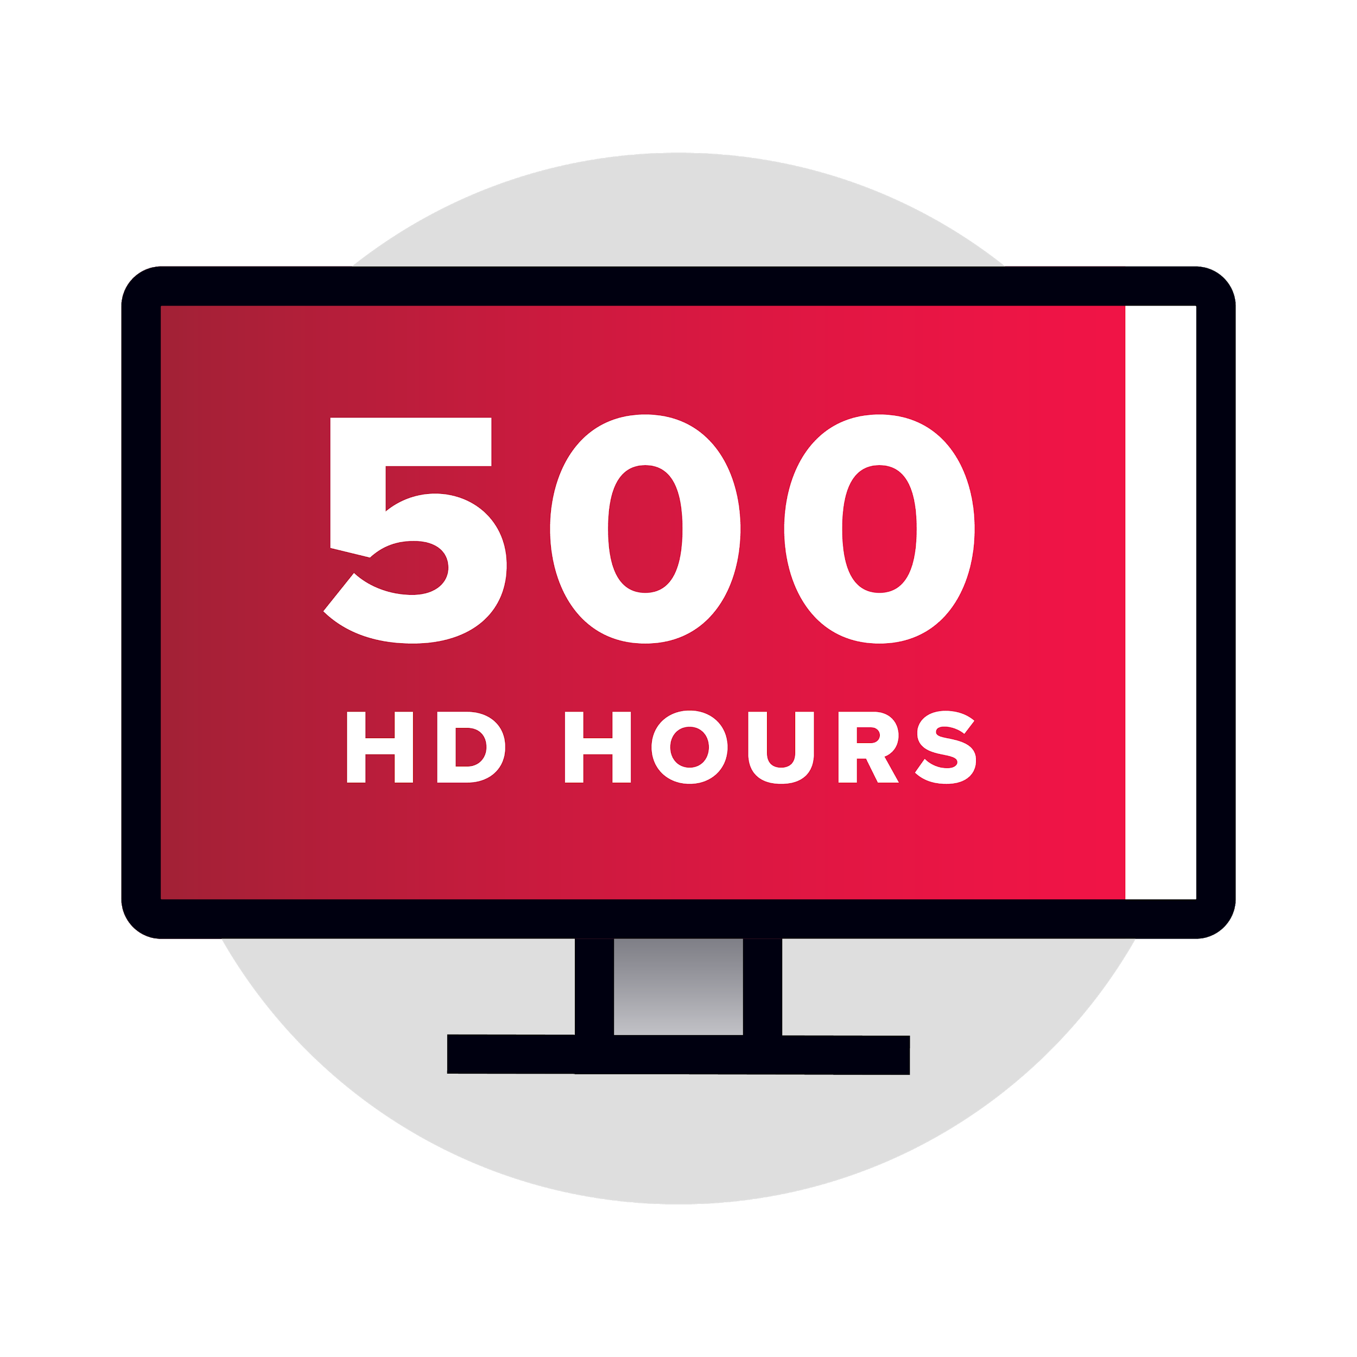
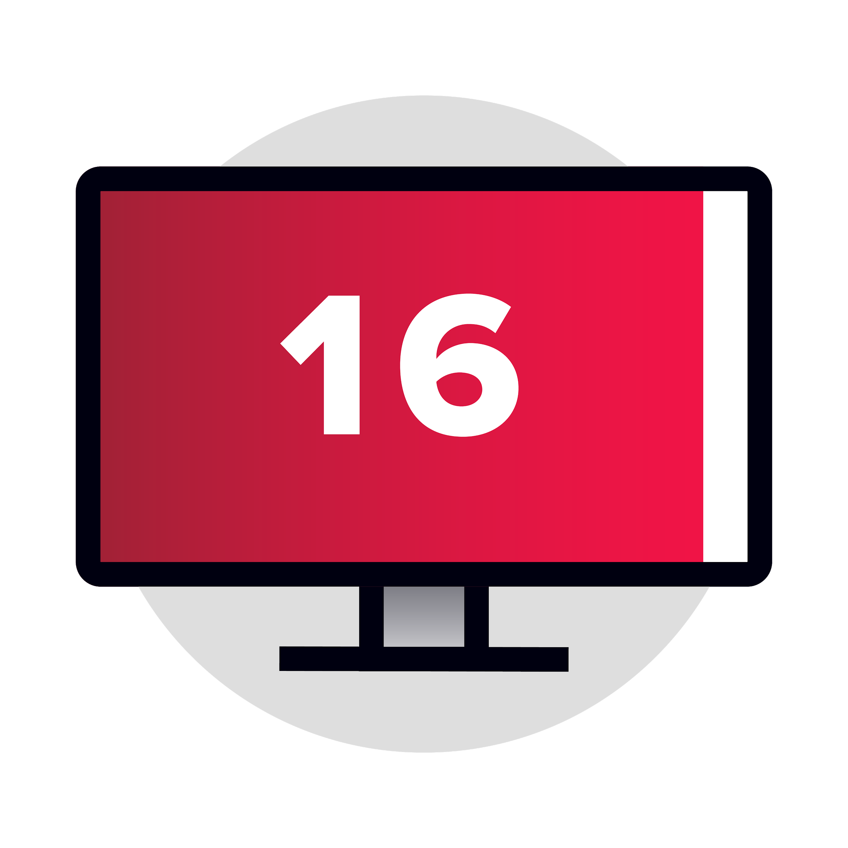
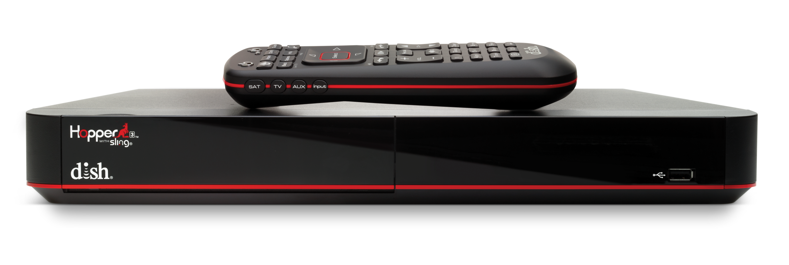
Hopper 3
Primetime Anytime & AutoHop
500 Hours HD DVR
16 Tuners
Dish Anywhere
Notes:
Pitch details – FEATURES AND BENEFITS
TALK: DISH has many features that distinguish us from other TV providers in the marketplace.
Here are some of the Top Features from the award winning Hopper 3:
CLICK
Primetime Anytime – this feature Automatically Records primetime shows on ABC, NBC, CBS, FOX during the hours of 8-11pm each day.
And, AutoHop automatically skips those commercials on the shows recorded on PrimeTime Anytime during playback without touching the remote!
CLICK
The DVR Stores 500 Hours of HD content – this is Double the Competition
CLICK
You can record 16 shows at once, say goodbye to recording conflicts
With Remote Finder there is no more searching under the couch and in between cushions. With the push of a button an alert will sound letting you know where your remote is. This feature is perfect for EVERYONE that has ever lost their remote!
Multi-view Feature allows you to Watch 4 HD programs at once, so you can catch all the sports on at the same time!
Smart search this feature is great if you want to watch a movie or show starring say… Jennifer Anniston, one search will find all of the available titles in the guide, DVR, OnDemand and Netflix!
CLICK
With DISH Anywhere - Watch 100% of your live and recorded TV anywhere – in the car, at the soccer field, at the beach, and just on the go!

Slide 6
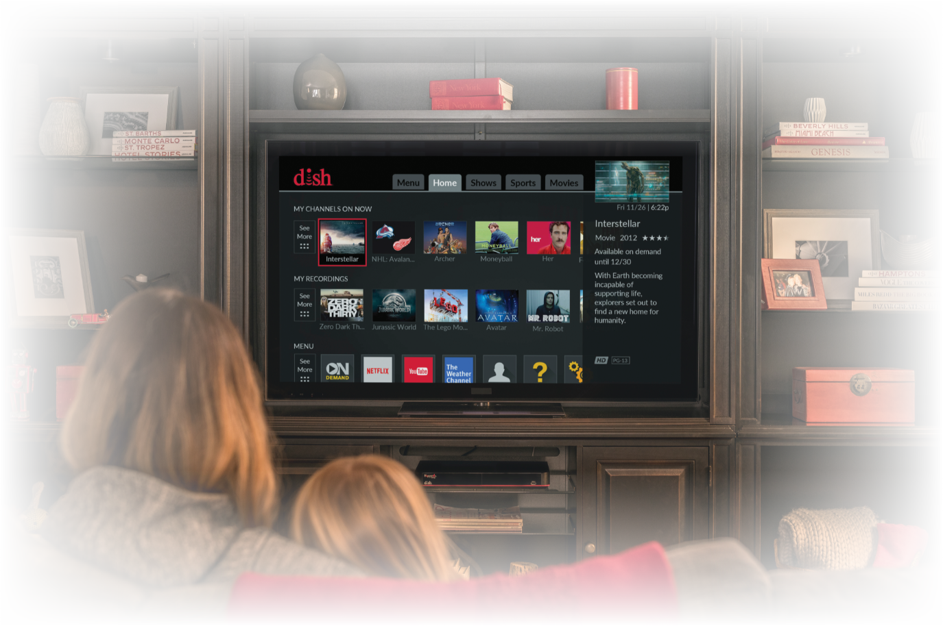
Apps: DraftKings Pandora Prime Video Weather Channel YouTube Kids Netflix Game Finder YouTube On Demand Over 80,000 Titles My Dish Access your DISH Account Trending Now What is everyone watching around you?
State of the Art User Experience
Notes:
Many customers love our state of the art user experience – this will allow customers to experience many things at their fingertips without having to change any inputs on their TV
We’ve integrated all the great apps into the Hopper 3 such as: Netflix, Prime Video, Pandora, YouTube, and the Weather Channel
Remember, people buy products based off of the experience they have with them.
So be sure to think about this as you’re having conversations with families, movie lovers, sports fans, and any other types of customers
If you’re talking about your favorite Netflix show/or movie with a customer, I’d mention that the Netflix app is in the Hopper with DISH
This means if you are looking for a favorite show or movie, the Hopper will automatically check Netflix for that programming too!
Easy built-in convenience!
If you’re talking with a customer who has a big family, tell them about our DVR. The Hopper can record up to 500 hours of content and our 16 tuners makes it easy for everyone in the home to watch and record at the same time.
Or, a family that likes to travel? Dish anywhere is a perfect feature to mention to them – take your TV with you!
Also, don’t forget you’re favorite features and what makes Dish stand out to you!
People can tell when you’re being genuine and real. So don’t be afraid to share a personal story on how Dish resonates with you.

Slide 7
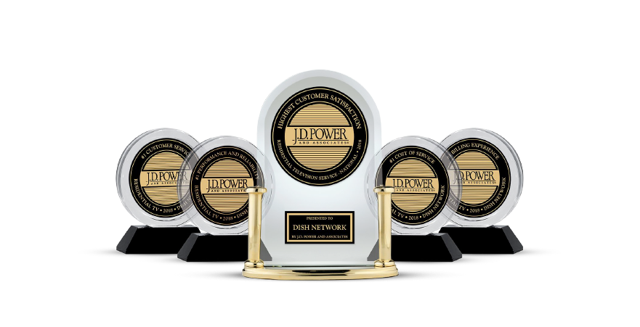
Why DISH?
Customer Satisfaction #1
Customer Satisfaction #1
Notes:
So Why DISH?
TALK: You and your customers should feel great about making the decision to sign up for DISH. Besides all the great exclusive features the Hopper 3 has we also have…
A 2 year Price guarantee! Which means your customer can rest assured that for the next 2 years their bill will not change!
Here is a great transition statement you can use “Dish has a 2 year price guarantee, this mean you are locked in with these great DISH deals for 2 years and your price will not change!
One of the great services we offer is Free Standard Professional Installation.
We have narrowed down your appointment time to a 75 minute window and most of the time we have Next-day installation appointments available. With the great mydish app you can real time track your technician right up to your door!
Each receiver includes a free Google Voice Remote, our remotes are integrated with the most advanced technology! Google assistant can show you your schedule for the day, or your commute but also allows a customer to search programming, launch apps, and control other Google devices just by pressing the google button on your remote!
Let’s do another transition statement for this one “ “You mentioned that you really enjoy the latest in technology on your phone and devices, so I wanted to let you know that DISH has award winning technology on their Hopper 3 which includes a google assistant powered voice remote! Let’s get you set up with the greatest TV entertainment service today!”
All of this great technology and attention to detail on customer experience has won us the JD Power and associates awards. Feel free to build your brand and your DISH sales by talking about these great awards we’ve achieved!
Here is a great transition statement to use “ We partner with DISH; who is ranked #1 in customer service, customer satisfaction, billing, cost of service and performance and Reliability by JD Power. Let’s get you scheduled for an install!”

Slide 8
The DISH Advantage
Our competitive advantage should be communicated
from a “thinking of the consumer first” point of view. What sets DISH apart is our VALUE, TECHNOLOGY, and SERVICE,
which break down barriers between consumers and the content they love. We refer to our products by the benefit they provide consumers, and our customer service through the awards
we’ve proudly won.
Notes:
The DISH Advantage
Our competitive advantage should be communicated from a “thinking of the consumer first” point of view. What sets DISH apart is our Value, Technology and service, which break down barriers between consumers and the content they love. We refer to our products by the benefit they provide consumers, and our customer service through the awards we’ve proudly won.

Slide 9
Value, Technology, Service
Value
DISH is the only TV provider to offer a 2-Year TV Price Guarantee
No fee for the first receiver, only with DISH
DISH Protect Silver Free for 6 months
Free Premium Channels for 3 months (Showtime, Starz, and DISH Movie Pack)
Free HD for Life
Free Professional Install
Technology
Get the ultimate voice control experience with the new DISH Voice Remote with Google Assistant built in
Only DISH lets you watch 100% of your live, recorded and On Demand content anywhere, on any internet-connected device
Watch and record up to 16 channels at once with the Hopper® 3 DVR
Record up to 500 hours of HD TV with the Hopper® 3 DVR
Get more HD channels nationwide than any other provider
Service
DISH guarantees 99% nationwide signal reliability
DISH is the industry leader in overall quality
Get answers now with DISH 24/7 customer support
Place your order today and get it installed in the same day
Notes:
So lets review the Value, Technology and Service that set DISH apart from the competition.
Read slide
Value
DISH is the only TV provider to offer a 2-Year TV Price Guarantee
No fee for the first receiver, only with DISH
DISH Protect Silver Free for 6 months
Free Premium Channels for 3 months (Showtime, Starz, and DISH Movie Pack)
Free HD for Life
Free Professional Install
Technology
Get the ultimate voice control experience with the new DISH Voice Remote with Google Assistant built in
Only DISH lets you watch 100% of your live, recorded and On Demand content anywhere, on any internet-connected device
Watch and record up to 16 channels at once with the Hopper® 3 DVR
Record up to 500 hours of HD TV with the Hopper® 3 DVR
Get more HD channels nationwide than any other provider
Service
DISH guarantees 99% nationwide signal reliability
DISH is the industry leader in overall quality
Get answers now with DISH 24/7 customer support
Place your order today and get it installed in the same day

Slide 10
2 Sales Process Options
Online Shopping Cart
Call-to-Order
OR
Benefits:
Fastest way to complete a sale
You are the DISH expert for the customer
Quick and easy!
Benefits:
Customers get one on one expert consultation from DISH
You just have to get the customer interested and let DISH do the heavy lifting!
Notes:
Now that we know plenty about DISH lets talk order entry
You as a IBO have 2 options to process sells
One option is your Online shopping cart located on your personal storefront
The benefits of this option are that you are utilizing the fastest way possible to complete your DISH Sale. You are the expert for DISH and can easily walk a customer through programming and equipment options – Quick and easy
The other option you have as an IBO is call to order – Your customer will get one on one expert consultation from DISH, you just have to get the customer interested and let DISH do all the heavy lifting!
Let’s learn more about these options
Either way you choose a DISH activation is 5 points!

Slide 11
How Do I Place an Order?
Get the customer to the Online Shopping Cart located on your Personal Storefront.
Add ACN IBO ID so you get credit for the order.
Encourage customer to take the soonest installation date.
Do Not Cancel current provider until a DISH certified installer confirms that you have a good signal.
https://myacn.com/us-en/homepage
5 Points for every DISH Activation
Notes:
CALL TO ACTION!
Get the customer to the ONLINE SHOPPING CART from your IBO Personal Storefront!
Make sure to Add your ACN IBO ID so you get credit for the order.
Encourage your customer to take the soonest installation date. Always use assumptive closing sentences to get that sale!
“Lets get you set up tomorrow. Is morning or afternoon best for you?”
Do Not Cancel current provider until a DISH certified installer confirms that you have a good signal.
For the Best Customer Experience please make sure that the customer includes their email address and their 2nd phone number. This way if they miss their call from the installer we have a few options to get in contact with the customer. This will increase your completion rate as we want to ensure every customer gets installed!
You have lots of tools and resources at your fingertips! Once you have identified a customer, get the conversation started. Get them excited about DISH and get the customer to your shopping cart!
Make every customer contact a DISH Sale!

Slide 12
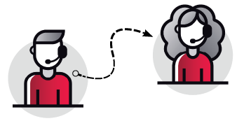
Call-to-Order Process
DISH Sales Team will consult with your customer
on the best promotion & equipment then complete
the order for you!
Here are some tips for this process:
This process will include calling a DISH national call center
This will be a 3 way calling process, so keep your customer on the line with you
The IVR will prompt you for an “Agent ID” – this is your IBO ID
DISH will not be able to give you credit for your hard work if the IBO ID is incorrect or is not provided
DISH Call-to-Order Hours of Operation
Monday – Sunday
9am – 11pm ET
Use your IBO store front hours or when needed
Notes:
The call to order process is simple – the DISH Sales Team will consult with your customer on the best promotion and equipment then complete the order for you.
Before we get into the process here are some thing you should know beforehand
This process will include calling a DISH national call center – not an ACN call center
This will be a 3 way call with you, your customer and the DISH Sales Agent
When you call in the IVR will prompt you to put in a “Agent ID” this is your IBO ID or IBO number – if you do not put this number in or if it’s incorrect we cannot tie that sale back to you and DISH won’t be able to give you credit for your hard work!
The DISH sales agent are able to help you Monday – Sunday from 9am to 11pm Eastern time zone
You can use this option during your IBO store front hours or when needed!

Slide 13
Call-to-Order Process
Easy Call-to-Order Steps
Step 1: Questions
Ask 2 qualifying questions prior to calling DISH:
Had DISH service in the past
Ask: “Have you ever had DISH service in the past?”
If the answer is Yes: “Great! You will need to provide your previous service address in a moment before we proceed.”
Why: Customers can only be considered “New” after being without service for 60 days and DISH will verify they do not have an outstanding balance
Credit Card Available
Ask: “Please have a valid debit or credit card with at least a $1 available balance ready. Do you have that ready?”
If the answer is No: “Is there anyone else in the household with one? If they are willing to be on the account with you that will work.”
Why: DISH requires a valid debit or credit card with a $1 available balance for a credit check.
Notes:
There are 4 easy steps to the call to order process – even though these slides are long the process is actually very, very quick!
Step 1 is asking 2 qualifying questions to ask your customer prior to calling the DISH phone number.
You need to gather this information then provide it to the 1st DISH agent which is the welcome agent
Ask your customer “Have you ever had DISH service in the past?” If the answer is no – great! They are considered a new customer.
If they say yes “they will have to provide their previous service address to the welcome agent.
A customer is considered new if they haven’t had DISH in the past 60 days and they do not have an outstanding balance
2nd question is “Please have a valid debit or credit card with at least $1 available balance. Do you have that ready?”
If they do not you can ask them if there is another person in the house that is willing to join on this account and use their card. Please note that whoever’s credit card they provide will be tied to the account, and will have a credit check run off that card. DISH does require the valid credit or debit card for a credit check.
We also cannot take a prepaid debit or credit card as it will not work in our systems because it can’t provide that credit check.
Easy! To review – 2 questions – Have you had DISH service in the past and Do you have a valid credit or debit card with at least a $1 available balance – have it ready!

Slide 14
Call-to-Order Process
Easy Call-to-Order Steps
Step 2: Calling DISH
Have your IBO ID ready and dial 1-800-222-5368
Dial DISH 1-800-222-5368
Press 1 for English or 2 for Spanish
Press 2 for New Customer
IBO ID
IVR will ask for your agent ID – input your IBO#
Press # to continue
Press 1 to confirm or 8 to
re-enter
Notes:
Step 2 – Call DISH
Get your IBO number ready before you dial!
Dial 1-800-222-5368 – if you dial any other phone number besides this one you will not get credit for your sale
Once you dial the phone number you will be prompted to press 1 for English or 2 for Spanish
Make sure you press 2 for NEW customer since you are creating a new sale – otherwise you’ll end up in customer service – and we need our 5 points!
The prompts will then ask for your AGENT ID – Input your IBO number press the pound key to continue then press 1 to confirm or 8 to reenter
If you do not put in a IBO number you won’t get your 5 points so be careful!

Slide 15
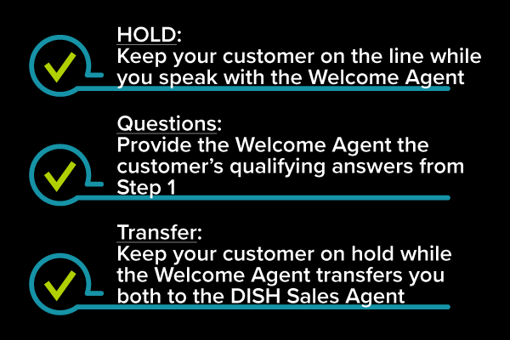
Call-to-Order Process
Easy Call-to-Order Steps
Step 3: DISH Welcome Agent
Notes:
Step 3 is when you will speak with the first of 2 agents – the Welcome agent
Your customer will come on this journey with you so keep them on the line when you speak to the welcome agent
You will provide this agent with the 2 qualifying questions you asked the customer in step one
Then both – you and your customer will be transferred to the DISH Expert sales agent!

Slide 16
Call-to-Order Process
To the new customer: “Mr./Mrs. _____, the DISH agent will now provide you with the information you need from here. Thank you!”
ACN IBO to DISH Sales: “Hi, my name is _____ from ACN. I have Mr./Mrs. _____ on the line who is interested in learning more about DISH services today.”
Easy Call-to-Order Steps
Step 4: DISH Sales Agent
2nd DISH Agent is Sales
You will need to provide the DISH Sales agent your customers Name and phone number
Bring the customer into the conversation and let the DISH Sales Agent take over speaking with the customer about their DISH services that are available to them.
DISH services will be activated after they are installed by DISH
5 Points for every DISH Activation
Notes:
Last step is to get the customer talking with the DISH Sales agent – This DISH agent will complete the sale end to end for you
The DISH Sales agent will come on the line and ask you for your customer’s name and phone number, we wrote some verbiage for you “Hi! I’m Andrea from ACN I have Mr./Mrs. Blank on the line who is interested in learning more about DISH services today. “
CLICK
And to the customer you can say” Mr./Mrs. Blank the DISH agent will now provide you with the information you need from here. Thank you!”
Most phones won’t allow you to drop off without closing all the calls – so you can just put yourself on mute and let the DISH sales agent and your customer continue the sale. No need to do anything else!
This is an easy way to get your customer expert advice on the right promotion and equipment and you make 5 points when the activation is final!
Congratulations to easy!

Slide 17
Thank you!
5 Points for every DISH Activation
Notes:
Thank you so much for your time today and we want to wish you luck and prosperity in all your sales opportunities! Remember to make every customer contact a DISH sale – Good Luck! Thank you!

